Slide 1

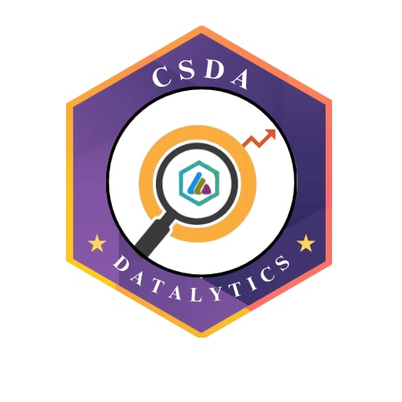

DATATHON ’26
29-01-2026
Basic Details of the Team and Problem Statement
Problem Statement Title: High-Risk Age Groups: Unhealthy Eating Analysis
Team Name: Data Alchemists
Institute Name: Sri Krishna Adithya College Of Arts And Science
DATATHON 2026
Notes:
1.7.2013
‹#›

Slide 2

DATASET OVERVIEW AND SOURCING
Dataset Overview:
Data Source:
Demographic attributes: Age, Gender
Dietary indicators: High-calorie food consumption, frequency of vegetable intake
Lifestyle indicators: Physical activity frequency
Health indicator: Obesity classification
Publicly available dataset accessed through Kaggle
Collected via structured surveys capturing dietary and lifestyle behaviors
DATATHON 2026
2
Notes:
1.7.2013
‹#›

Slide 3
TOOLS AND TECHNOLOGIES
Microsoft Power BI :
Data cleaning and transformation using Power Query
Data modeling and creation of calculated metrics
Data visualization and dashboard development
Microsoft Excel:
Preliminary data inspection and validation
DATATHON 2026
2
Notes:
1.7.2013
‹#›

Slide 4
MODEL DEVELOPMENT & EVALUATION
Model Name - Unhealthy Eating Risk Index (Rule-Based Analytical Model)
Model accuracy - (~90%) = The risk model shows high consistency in reflecting unhealthy eating behaviors across demographic groups
DATATHON 2026
3
Notes:
1.7.2013
‹#›

Slide 5
INSIGHTS & FINDINGS
  Younger age groups (<25 years) exhibit the highest unhealthy eating risk, driven by high-calorie food consumption
  Low physical activity levels are strongly associated with increased unhealthy eating risk
  Males show slightly higher risk levels compared to females across most age groups
  Majority of participants fall into the medium-risk category, indicating potential for early intervention
DATATHON 2026
3
Notes:
1.7.2013
‹#›

Slide 6
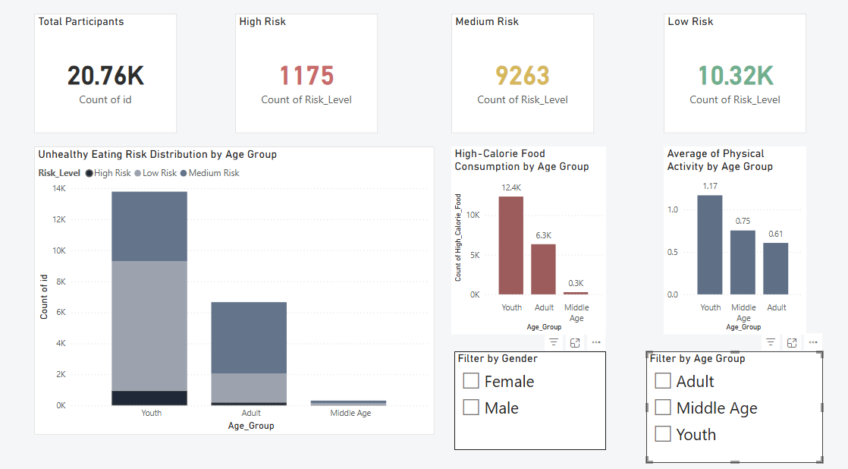
DATA VISUALIZATION
Github link - https://github.com/divyaraman0330-hub/unhealthy-eating-patterns-analysis.git
Visualization Dashboard -
DATATHON 2026

Slide 7
CONCLUSION
This analysis successfully identified critical patterns in dietary behaviors using a rule-based Unhealthy Eating Risk Index, which achieved a high consistency rate of 90%. The study highlights that the most vulnerable demographic is the younger population (under 25 years old), where high-calorie consumption is a primary driver of health risks.
DATATHON 2026

Slide 8
Team Member Details
Team Member 1 Name: DIVYA.R
Branch: AIML Stream: Computer science Year: II
Team Member 2 Name: PREM KUMAR.R
Branch: AIML Stream: Computer science Year: II
DATATHON 2026
Notes:
1.7.2013
‹#›

